Slide 1
Introductory Coach Award

Slide 2
Why is Squash a good sport for clubs and schools?
Squash is a great school and club sport because it is:
Played by both boys and girls
Suitable for all ages and levels of ability
Fun in a short time
Can be played at all ages, by all abilities, a game for life
Low impact sport for children

Slide 3

Squash develops all round physical skills important for school age children including:

Slide 4
Squash develops all round physical skills important for school age children including:
Hand eye co-ordination
Catching and throwing
Stability and balance
Tactical thinking
Decision making
Speed and agility – the ability to change direction quickly

Slide 5


Before you start, think of:
Coaching facility – Number of courts, size and wall area of school hall/sports centre
Is the facility safe? – Risk Assessment
Emergency and fire evacuation procedures
Who to call in an emergency
Who you are going to coach? - ability, age, special requirements, number of players
Emergency contact numbers and medical information
First Aid Provision
Equipment required? – rackets, balls, eye protection

Slide 6

The need for safety!
All junior players to wear appropriate eye protection
Discipline – players must STOP immediately when asked
Surface is appropriate and free from obstruction
Keep loose squash balls in a container
Enough space for each player/group
Ensure players are wearing appropriate clothing and footwear. Jewellery should be removed
Introduce the concept of a LET as soon as possible
Do not let anyone enter a squash court without warning
Encourage balls to be retrieved with care

Slide 7
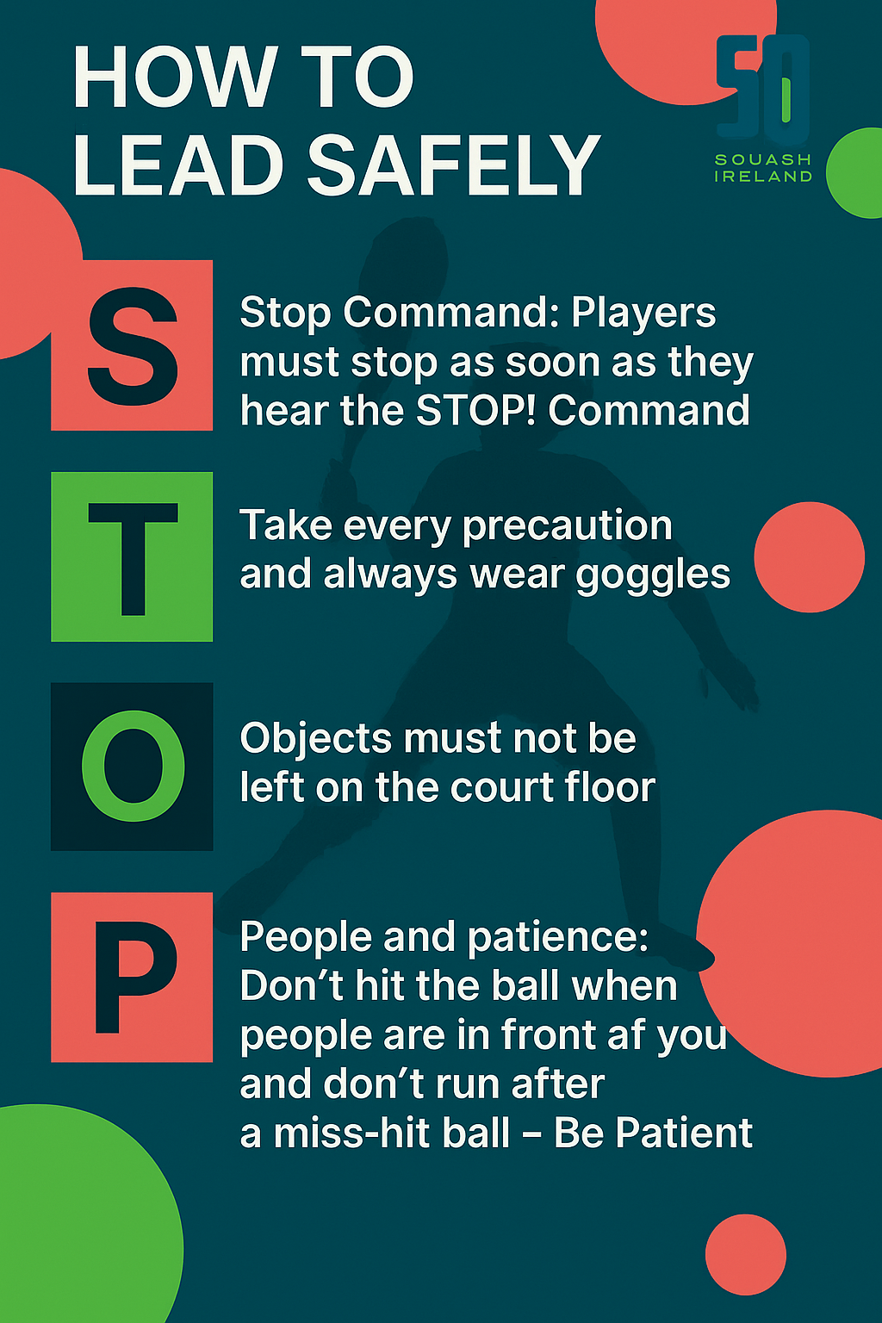

Slide 8
Attributes of a coach
Teacher
Manager
Psychologist
Motivator
Advisor
Role Model

Slide 9
HOW TO COACH

Slide 10
Leadership Styles
Coach led, participant led, individual and group work
Set Up and Stand Back – knowing when to let players learn through doing and discovery without leadership intervention
Show and Tell – demonstrate & explain
Ask and Think – the leader asks questions to encourage thinking and problem solving

Slide 11
Delivering a session
It is common to use the IDEAS or WWWH principle from the WSF philosophy
… are we trying to do?
Why
… are we doing it?
When
… do we do it?
How
… do we do it?
What

Slide 12
Demonstrations
AIM: to demonstrate what ever the activity may be
It can be:
Use of a video?
Shadow someone?
A photograph?
Or another Player?
The coach

Slide 13
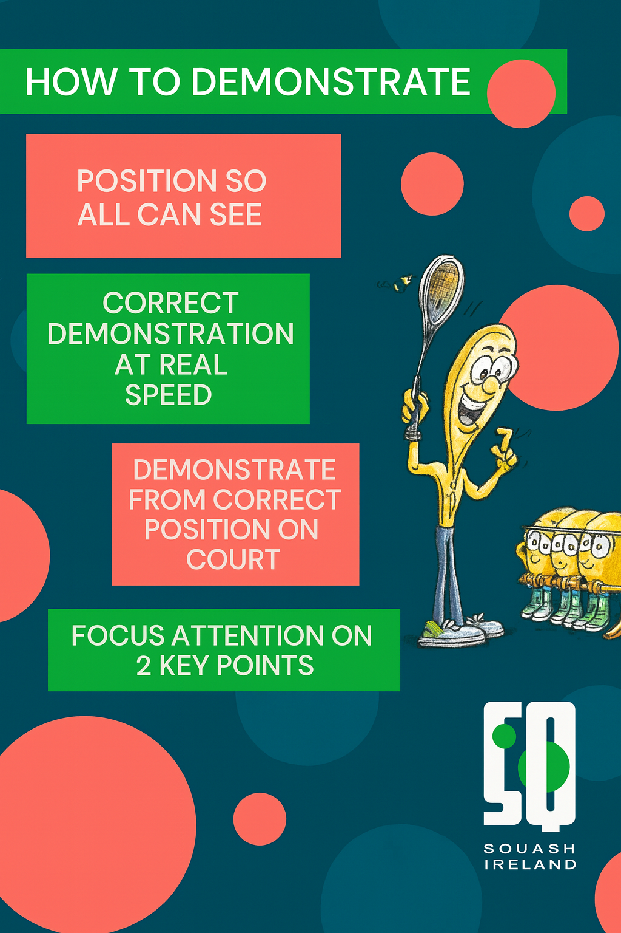

Slide 14
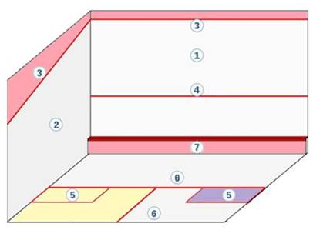
The court:
OUT
LINE
FRONT WALL
SQUASH SERVICE LINE
SIDE WALL
THE “TIN”
SERVICE BOX
BACK
WALL
HALF COURT LINE
SHORT
LINE

Slide 15
Evaluating your session
After each session you should go back and review it i.e. how well did it go? The session should be reviewed under the following headings :
Goals – Did you achieve your goals?
Active – Were the players engaged physically?
Variety – Did the session have different learning styles?
Was it FUN?
Interest – Did the session hold the players attention?

